Slide 1
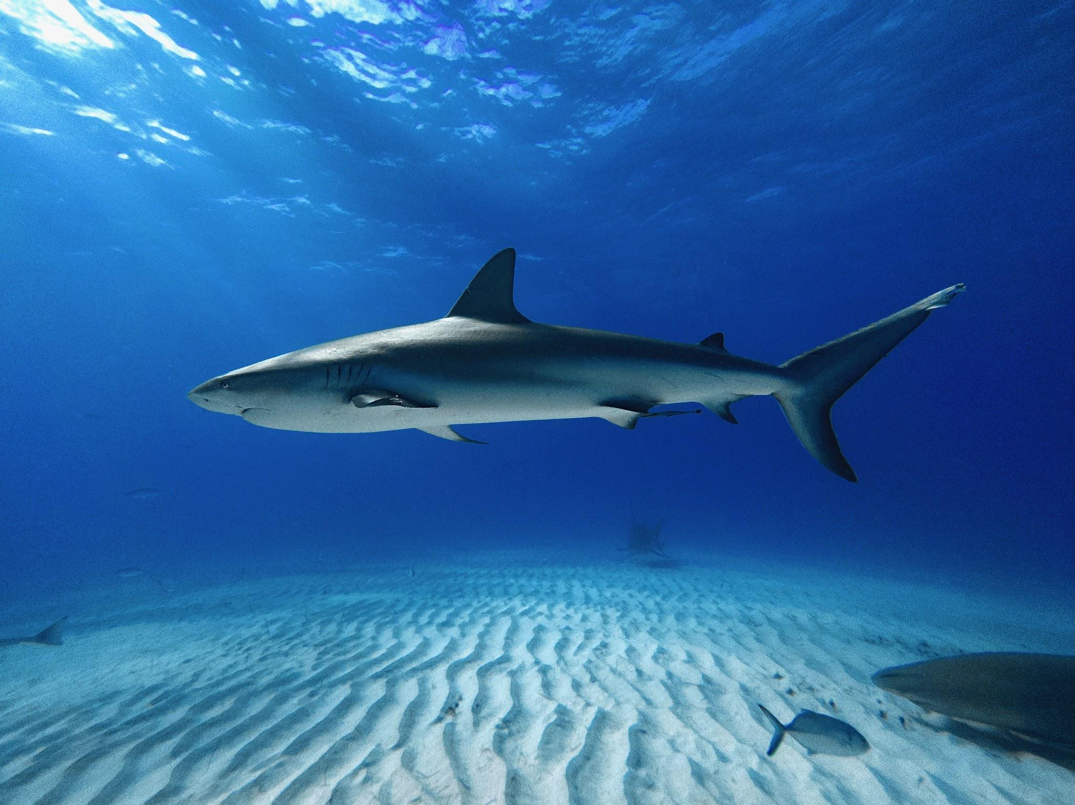
Sharks and Marine Protected Areas
Gian Villafañe, Dylan Sedeno,
Eduardo Da Silva, Radley Joseph,
Maya Wilson-Fernandez

Slide 2
Project Overview
The Python code is designed to focus primarily on data detailing global shark attacks and data based on NOAA's Marine Protected Areas.
It involves several key steps like extensive cleaning and formatting and the extraction of specific components like month and year from dates.
It categorizes months into seasons and refines the dataset to focus on US-based attacks, distinguishing between provoked and unprovoked incidents. It also groups data to analyze seasonal trends and demographic patterns in shark attacks.

Slide 3
Problem Statement
We are a marine research organization assessing the relationship between marine protected areas / shark sanctuaries and frequency of shark attacks on humans.
Understanding the relationship between the establishment of marine protected areas (MPAs) and shark sanctuaries and the incidence of shark attacks is crucial for effective conservation management. With global shark populations in decline and increasing human-shark interactions, it is imperative to analyze whether the presence of MPAs and sanctuaries influences the frequency and severity of shark attacks on humans. This study aims to assess how these protected zones impact shark behavior and interactions with people, providing data-driven insights to refine protective policies and enhance coexistence.

Slide 4
Hypotheses
Hypothesis 1 - Shark attacks are less prevalent in Marine Protected Areas due to increased protections and more food sources.
Hypothesis 2 - Unprovoked attacks are more prevalent in Marine Protected Areas.
Hypothesis 3 - Shark attacks are more prevalent in warmer seasons like spring and summer.

Slide 5
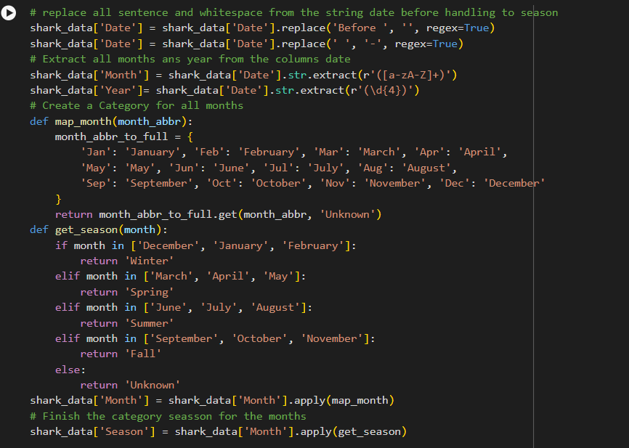
Data Structuring - Example
This code is designed to add a new column called 'seasons' to the dataset, which categorizes each shark attack by the season it occurred in, based on existing date data.
This process not only helps in structuring the data but also serves as a crucial step in cleaning and organizing the dataset

Slide 6
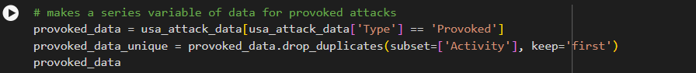
Data Filtering - Examples
This code filters the DataFrame to include only the rows where the 'Type' column has values that are not equal to 'Provoked' in the first example, and 'Unprovoked' in the second example.
This is done to isolate the data containing the unprovoked shark attacks in order to prove the hypothesis.

Slide 7
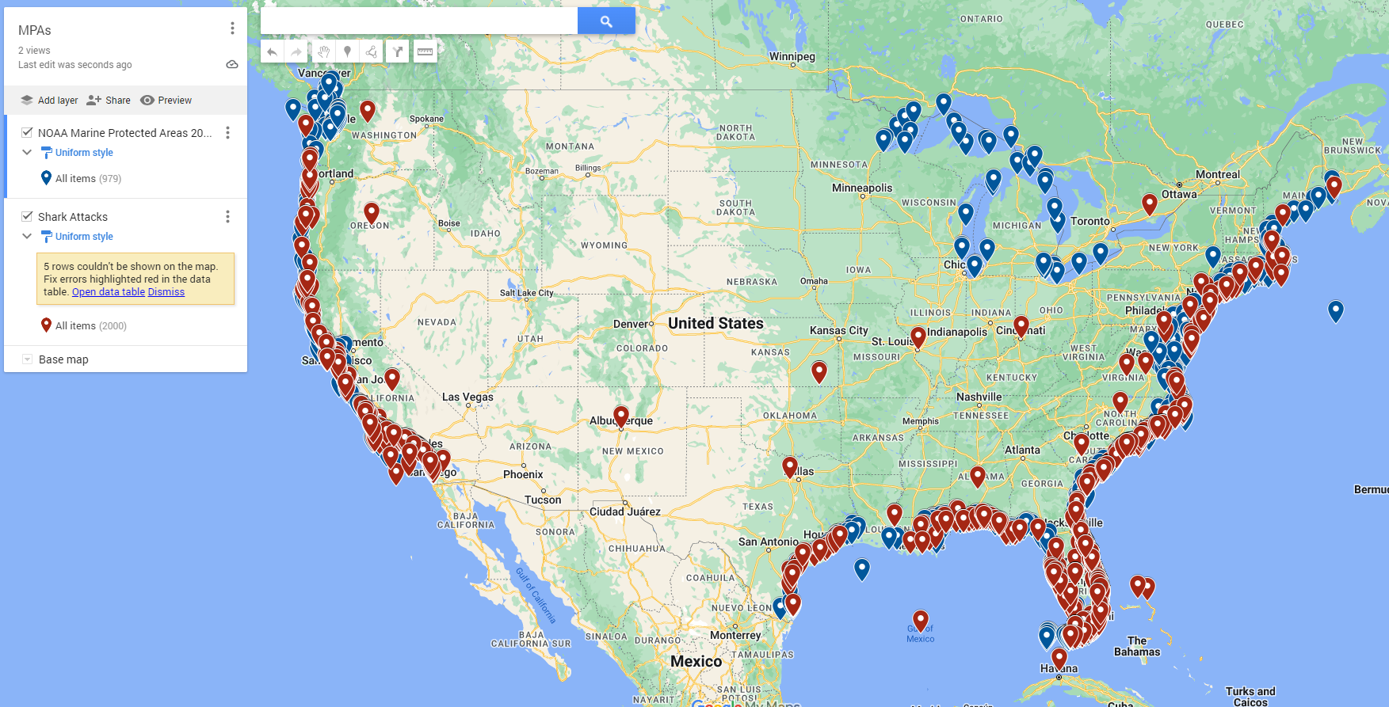
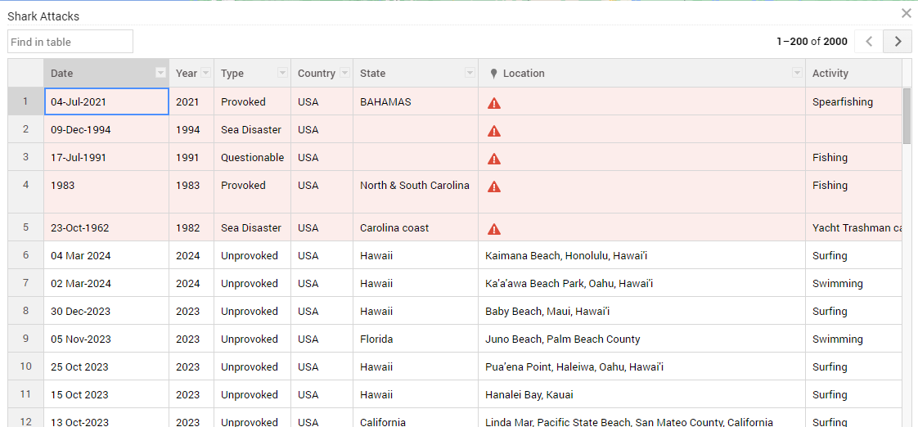
Creating a Map
Found another dataset from NOAA to cross-reference
Google MyMaps
Different location formats (Shark Attacks didn’t have latitude and longitude)
Couldn’t figure out how to transfer areas within MPA locations to see overlap

Slide 8
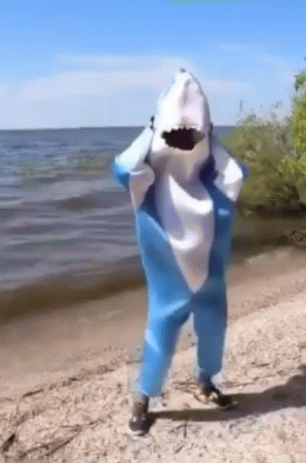
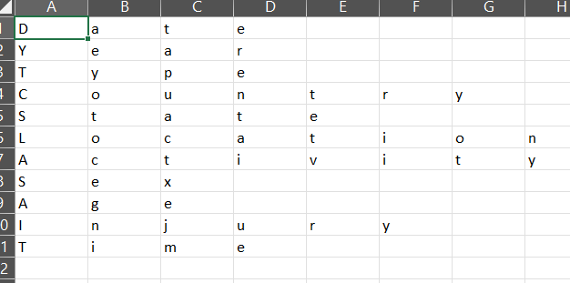
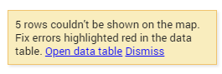
Major Obstacles
Inconsistencies in location data format
Cleaning and formatting the data
Filtering and wrangling
Saving altered data set to new CSV file
Solution: dataframe.to_csv('name_of_file.csv', index=False)

Slide 9
Exploratory Data Analysis
In this exploratory data analysis of shark attack data, we aimed to discern seasonal trends and spatial patterns, specifically the impact of Marine Protected Areas.
Initial data processing cleaned date columns and categorized them by seasons, showing a significant increase in shark attacks during the warmer months of Summer and Spring compared to Fall and Winter.
Our study on the impact of Marine Protected Areas on shark attacks was inconclusive due to insufficient geographic details; more precise location data is needed for a comprehensive evaluation.

Slide 10
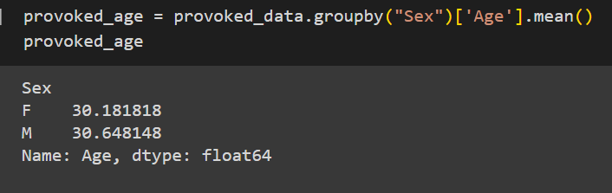
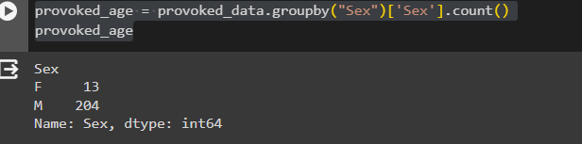
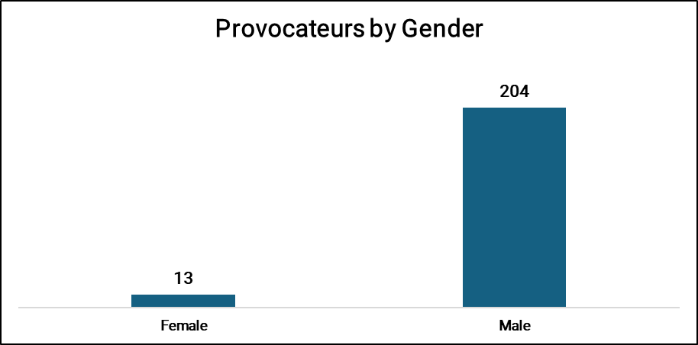
Exploratory Data Analysis
As an extra study for the excess of Provoked data, we decided to do a correlation analysis to see if age and gender played a factor in these attacks.
As a result we see that the average age for both male and female provoked attacks are 30 years old.

Slide 11
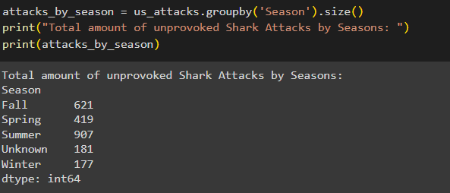
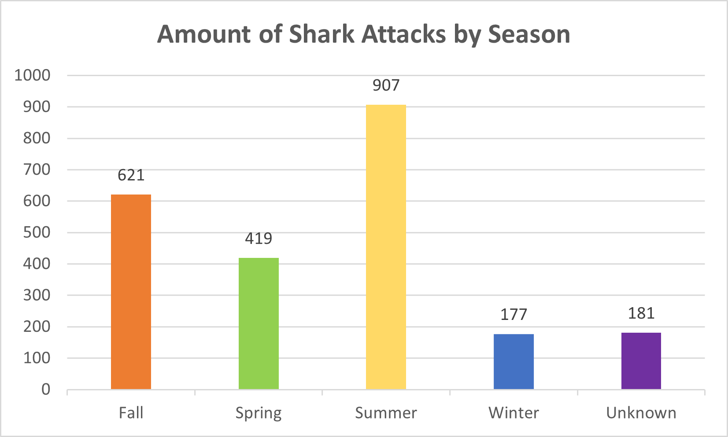
Conclusion and Insights - Hypothesis 3
The data clearly supports Hypothesis 3, showing that unprovoked shark attacks are more frequent in the Summer, with 907 reported incidents, followed by Spring with 419 .
This compares to lower numbers in the colder seasons of Fall with 621 attacks and Winter with 177 attacks.
The data confirms that warmer seasons see a heightened risk of shark attacks, aligning with the seasonal behavior patterns of both humans and sharks.

Slide 12
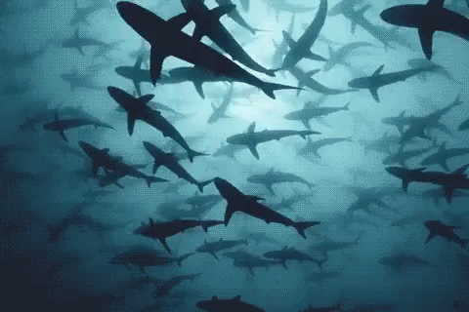
Thank you!
Thank you!

Slide 13
Sources
NOAA. (n.d.). The MPA Inventory. The MPA Inventory | National Marine Protected Areas Center. https://marineprotectedareas.noaa.gov/dataanalysis/mpainventory/
Shark Research Institute. (n.d.). Incident Log. Retrieved from https://www.sharkattackfile.net/incidentlog.htm

